Slide 1
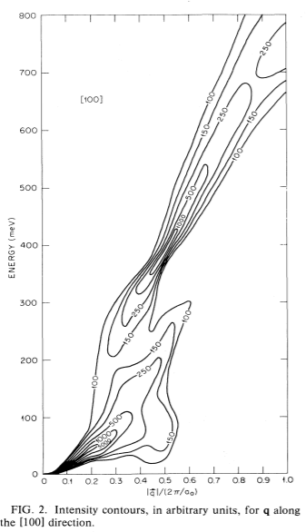
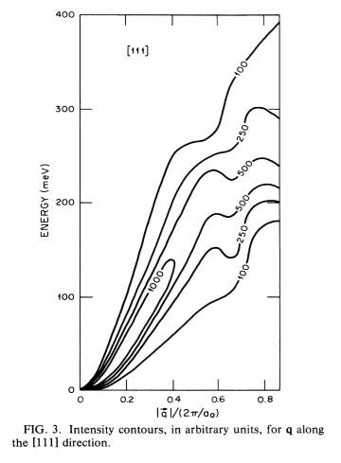
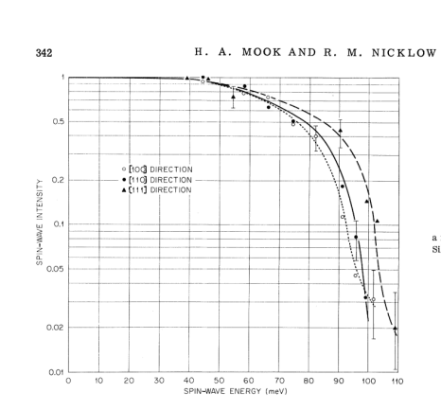
Spin wave excitations in Fe on the basis of band theory
Theory:
Experiment:
Blackman, J. A., Morgan, T. & Cooke, J. F. Prediction of High-Energy Spin-Wave Excitation in Iron. Phys. Rev. Lett. 55, 2814–2817 (1985).
Mook, H. A. & Nicklow, R. M. Neutron Scattering Investigation of the Magnetic Excitations in Iron. Phys. Rev. B 7, 336–342 (1973).

Slide 2


270
255
75

Slide 3
Looking for gap in 75-? mEv energy range
Exists:
Some vague pictures sowing evidence
Needed:
Better spherical cut
Resolution deconvolution
Symmetrisation

Slide 4
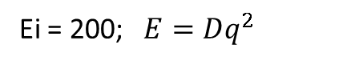
Ei = 200; $E=Dq^{2}$
Bragg 110, Directions [100] (ΓH), dE=2.5, dK=0.1
|D|=198 [meV*Α⁻²]
Bragg 1(-1)0, Directions [100] (ΓH), dE=2.5, dK=0.1
|D|=207 [meV*Α⁻²]
Bragg 200, Directions [100] (ΓH), dE=5, dK=0.1
|D|=230 [meV*Α⁻²]
dE=70-75, <±1,x,y> dK=0.2
dE=100-105, cut <0,x,y> dK=0.2
Gap

Slide 5
Looking for gaps in dispersion: Spherical Cut:

Slide 6
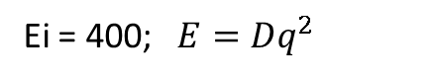
Ei=186 Bragg 200, Directions [100] (ΓH), dE=5, dK=0.1
|D|=237 [meV*Α⁻²]
Ei = 400; $E=Dq^{2}$
Bragg 110, Directions [100] (ΓH), dE=5, dK=0.1
|D|=237 [meV*Α⁻²]
Bragg 200, Directions [100] (ΓH), dE=5, dK=0.1
|D|=230 [meV*Α⁻²]
SW intersection observed at dE~250 in direction 200->3(-1)0?
Gap?

Slide 7
Searching for sw “Roof” at point “N” (1/2,1/2,0) at 250 mEV
Exists:
Pictures showing rooftop
Needed:
Q-dE cut

Slide 8
Catching N point (½, ½,0)
Ei=401
Ei=787
dE=200+20
dE=200+20
Ei=787
dE=220+20
dE=220+20
dE=220+20
dE=240+20
dE=240+20
dE=240+20
Π-no
- spur
dE=260+20
dE=260+20
dE=260+20
dE=280+20
dE=280+20
dE=360+20
Ei=787
dE=300+20
dE=320+20
dE=340+20
Removed background

Slide 9
Symmetrized cuts:
Ei 400; 111 (u=[1,-1,1])

Slide 10
Ei 400; 111 (u=[1,-1,-1])

